Slide 1
caArray Silver Compatibility Review
Juli Klemm
Eric Tavela
NCICB
February, 2008

Slide 2
Agenda
Project overview
  What is caArray
  Goals in bringing Bioconductor to caBIG
  Strengths and challenges
Domain Model
  Overall approach
  Microarray data modeling
  Imported classes
Architecture and APIs
  Architectural overview
  API description
  Test and adoption
Project status
  Availability
  Silver submission package
Maki and Juli to update
Maki to update

Slide 3
Project Overview: caArray
Vision
Technical strengths
  Simplified domain model and API (from caArray 1.x)
  Efficient storage and retrieval of microarray data
  Support for MAGE-TAB import
  Focus on usability
User community
Unique features
Update by Maki
Update by Maki
Update by Maki and Eric

Slide 4
Project Overview: caArray
Insert Screen shots

Slide 5
Project Overview: Goals in caBIG
Scientific use case exemplars

Slide 6
Project Overview: Strengths and Challenges
Vocabulary and common data elements
  Enforced APIs documentation
    Often very complete
  Diverse coding styles
    No consistent naming conventions
    Conflicting data types
  Language flexibility
    Ad hoc data types, e.g., instances missing data elements
  Interactivity
    Flexible work flows rather than standardized APIs
Architecture
  Single user, rather than client-server
  Very different from Java
Change to caArray info: Eric

Slide 7
Domain Model: Overall Approach
As simple as possible*
  *but no simpler
  Microarray data, annotation and workflow still complex to capture
Ensure high-enough resolution to capture data from:
  MAGE-TAB
  caArray 1.x
  Other stakeholder requirements
Optimize for efficient storage and transfer of microarray data
Re-use existing classes from other models where appropriate

Slide 8
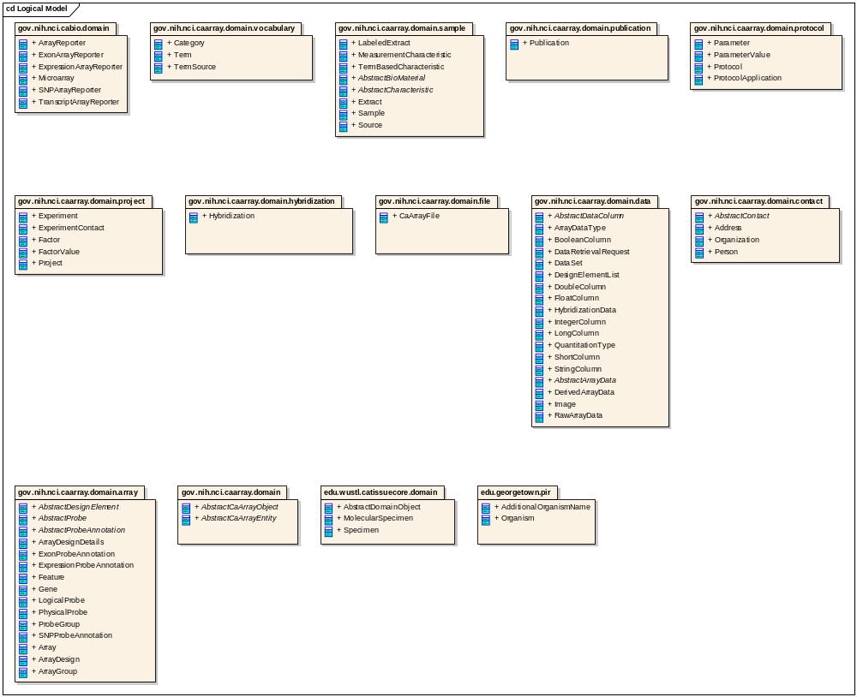
Domain Model: Packages

Slide 9
Data models: caDSR

Slide 10
Data models: CDE

Slide 11
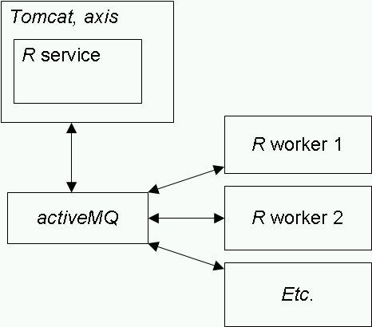
Architecture: overall approach
From R to Java
  Manually
    Granularize R workflows into functions
    Use class and other mechanisms in R to parameterize types
  Computationally map R to Java
    Include documentation from R
    Separate front end from ‘worker’
Multi-user service
  Embed R in Java
    Data transfer in C, with JNI
  Leverage Java Messaging Service to separate service front-end from workers
caBIG silver and gold
  ‘Usual’ Java process
Change to caArray info: Eric

Slide 12
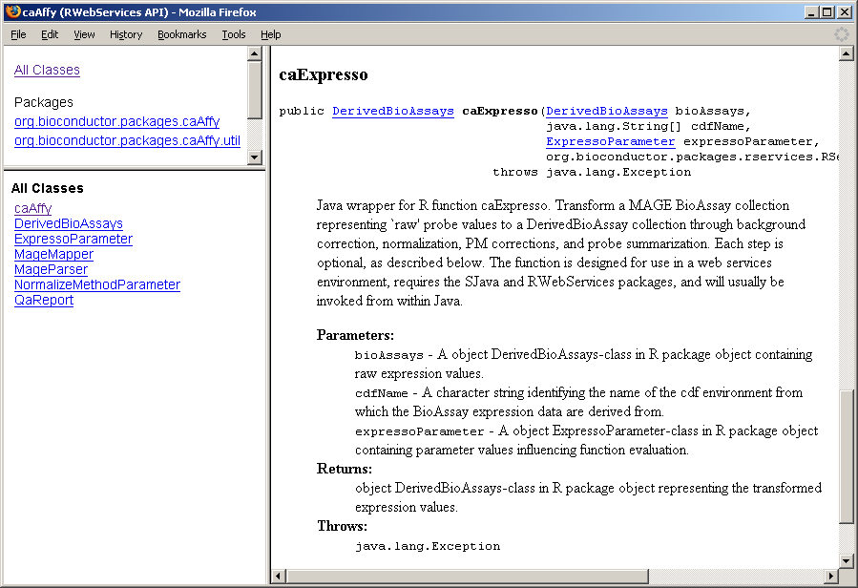
Architecture: method APIs
Change to caArray info: Eric

Slide 13
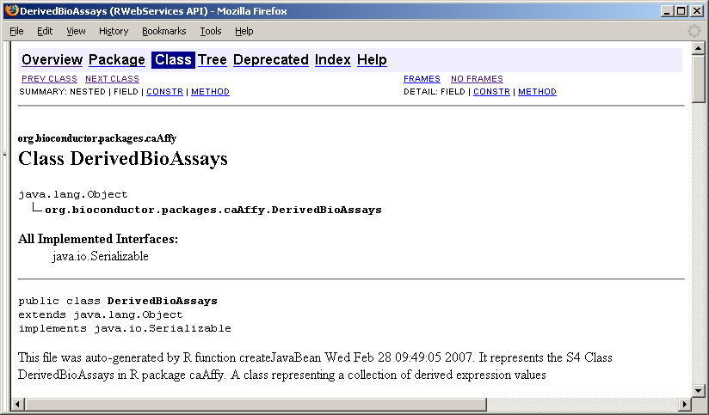
Architecture: data APIs
Change to caArray info: Eric

Slide 14
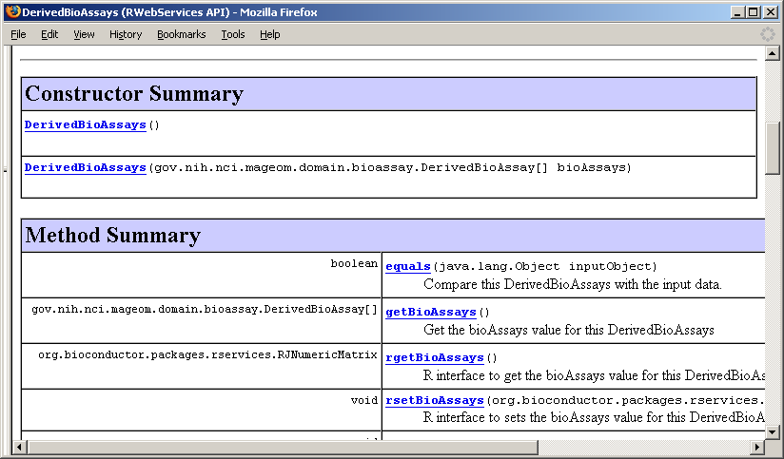
Architecture: data APIs
Change to caArray info: Eric

Slide 15
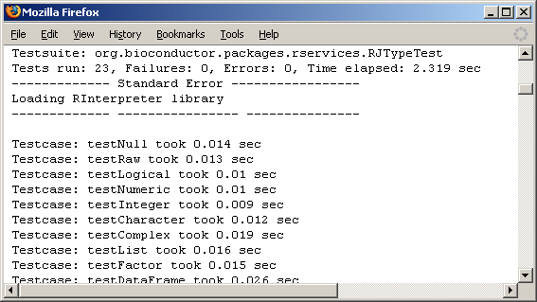
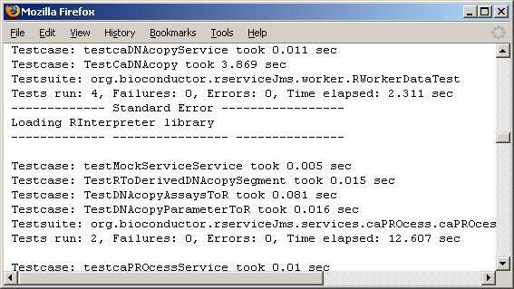
Architecture: test and adoption
Tests
  Java unit tests
    Underlying R – Java data transfer
    Service-specific data transfer and method invocation tests
  Integration tests
    Local invocation
    Simple caGrid client invocation
Adopters
  Successfully deployed and tested three packages
  Developed an additional in-house package
Change to caArray info: Maki to coordinate with Rashmi

Slide 16
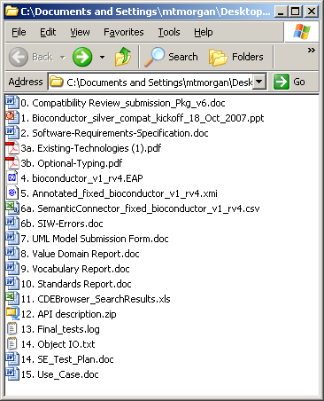
Project status
Available on gForge in CVS
  https://gforge.nci.nih.gov/projects/bioconductor
Silver compatibility package available
  http://gforge.nci.nih.gov/frs/?group_id=108
  Standards relevant at time of project completion (March, 2007)
Services are grid-enabled
‘Easy’ to expose additional services
  http://wiki.fhcrc.org/caBioc
Change to caArray info: Maki / Eric

Slide 17
Participants
Development
  Nianhua Li, Martin Morgan, Seth Falcon, Robert Gentleman, Fred Hutchinson Cancer Research Center, Seattle, WA
Mentoring
  VCDE: Salvatore Mungal, Duke Comprehensive Cancer Center, Durham, NC
  ARCH: Patrick McConnell, Pankaj Agarwal, Duke Comprehensive Cancer Center, Durham, NC
Adoption
  Warren Kibbe, Simon Lin, Pan Du, Denise Scholtens, Dong Fu, John Osborne, Julie Zhu, Robert H. Lurie Comprehensive Cancer Center, Chicago. IL
Booz-Allen oversight – Integrative Cancer Research
  Julie Klemm, Curtis Lockshin
Change to caArray info: Maki to coordinate with Juli

